Slide 1
Reinforcement learning
Episode 4
Deep reinforcement learning

Slide 2
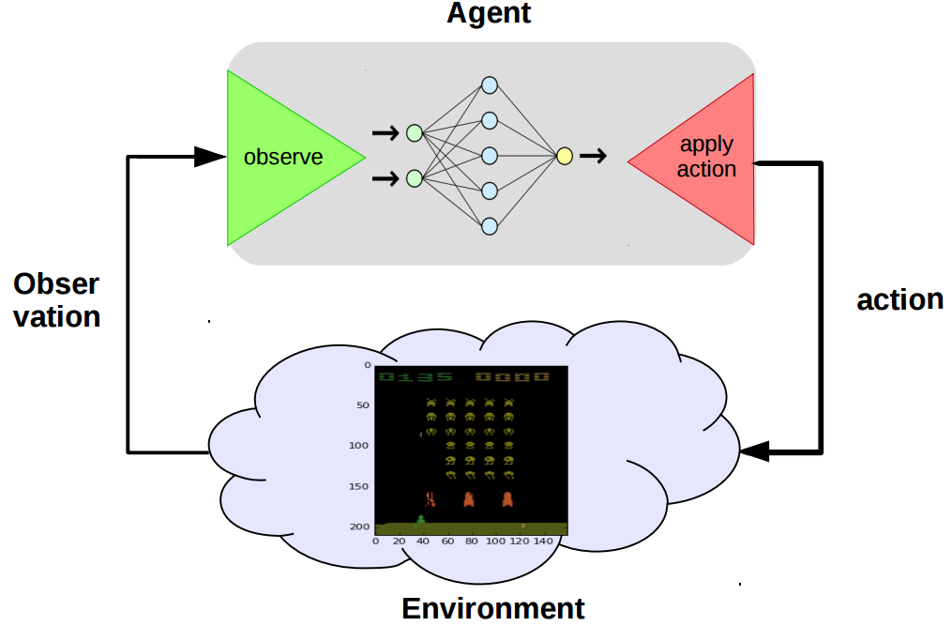
MDP

Slide 3
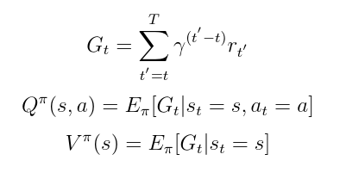
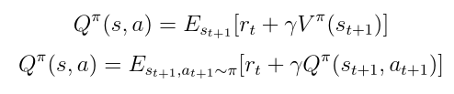
Basic definitions
Recurrent relations

Slide 4
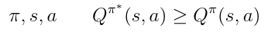
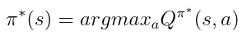
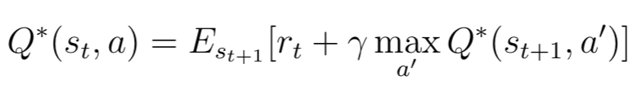
Optimal policy
For all :
Bellman optimality equation

Slide 5
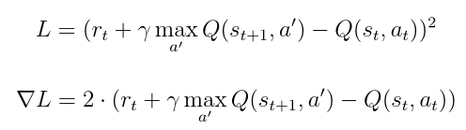
Q-learning
Training step
Q-learning as MSE minimization
Const
What’s wrong here?

Slide 6
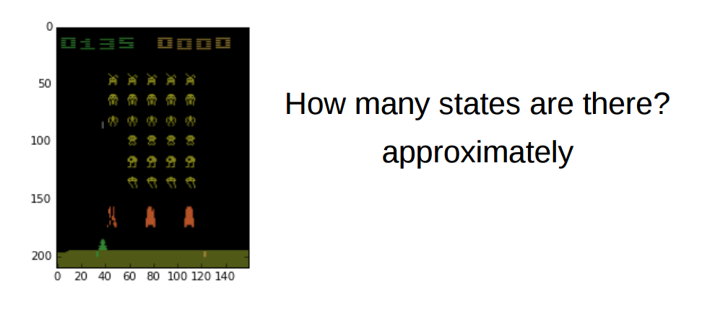
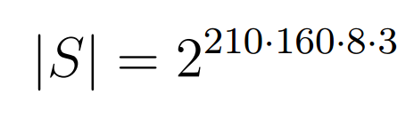
Real world

Slide 7
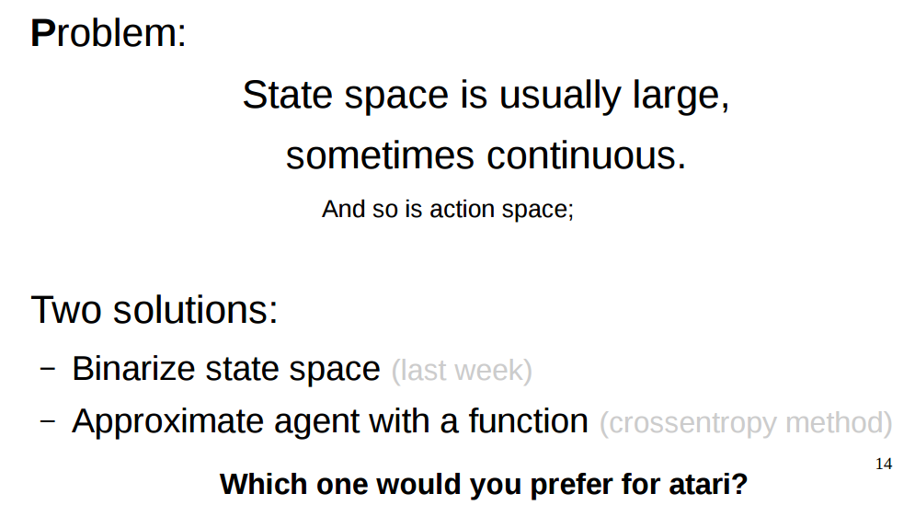

Slide 8
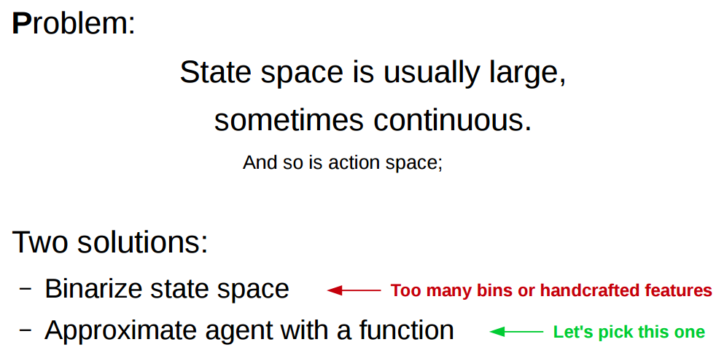

Slide 9
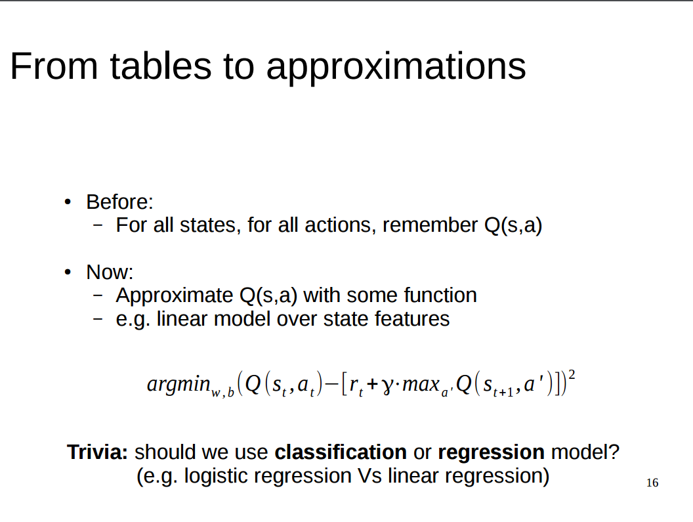
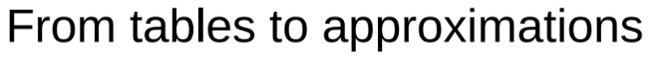
Question:

Slide 10
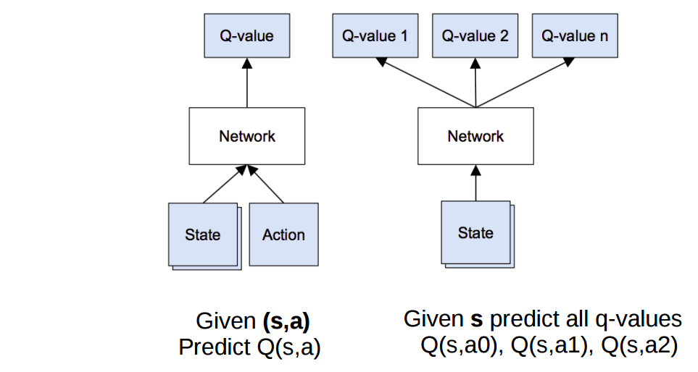
Possible architectures
Continuous control or large number of actions
One pass for all actions

Slide 11
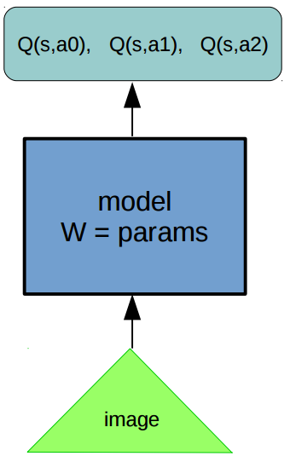
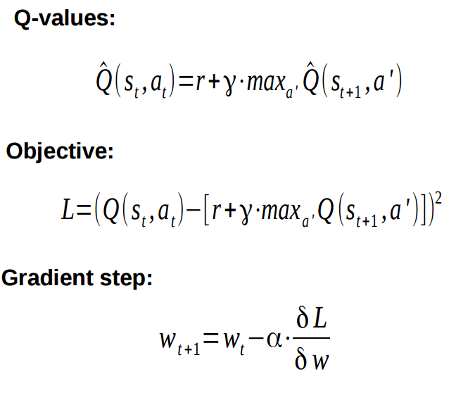
Approximate Q-learning
Const

Slide 12
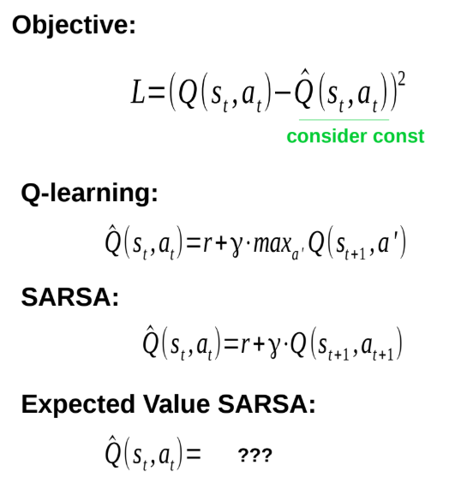
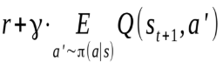
Approximate Q-learning

Slide 13
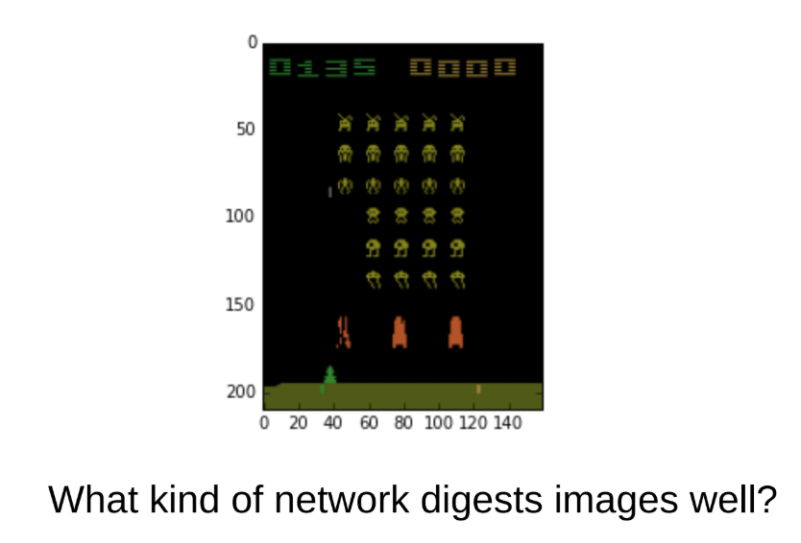

Slide 14
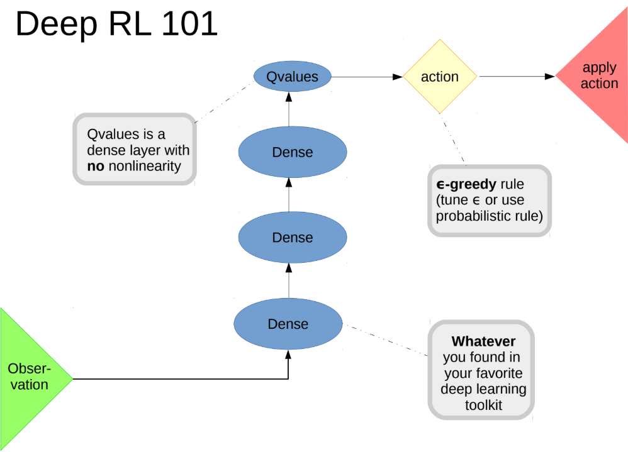
Basic deep Q-learning
Dense
Conv
Conv

Slide 15
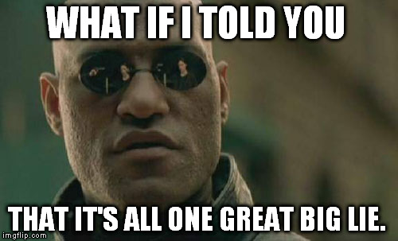

Slide 16
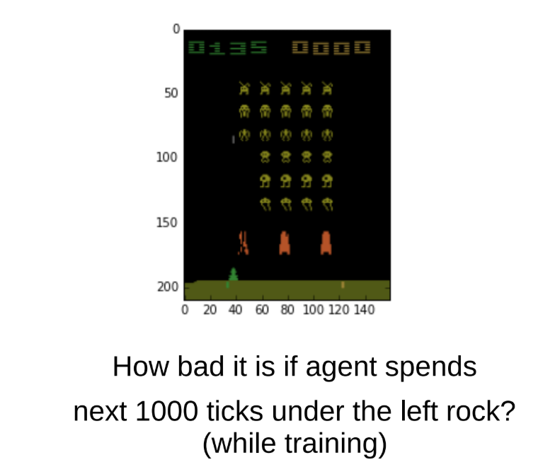

Slide 17
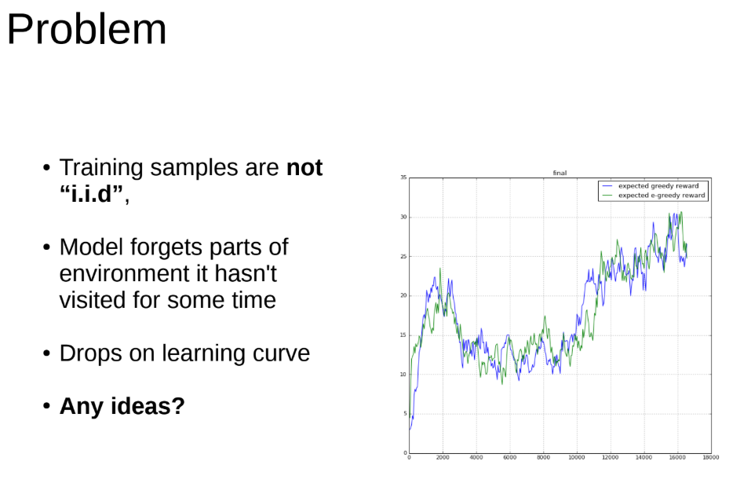
Problem

Slide 18
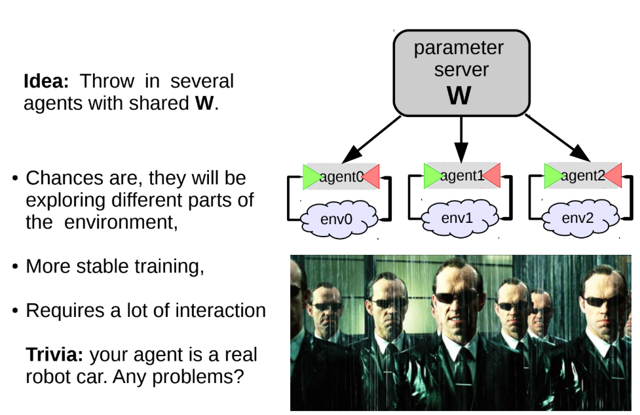
Multiple agent trick
Question:

Slide 19
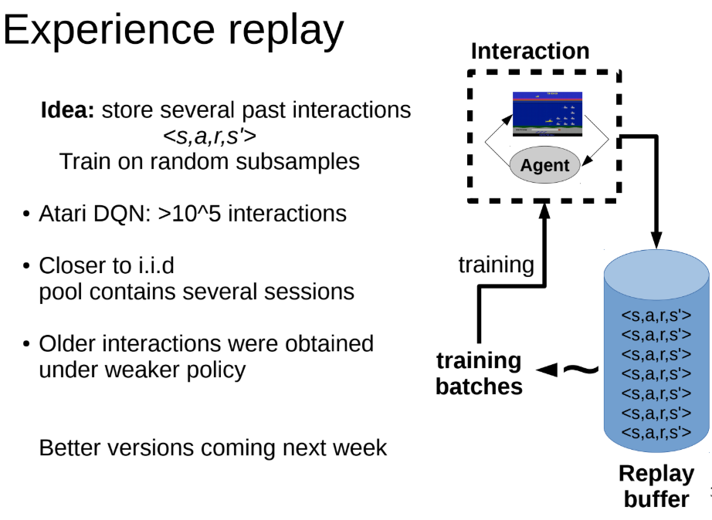
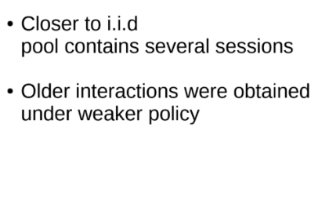
Experience replay

Slide 20
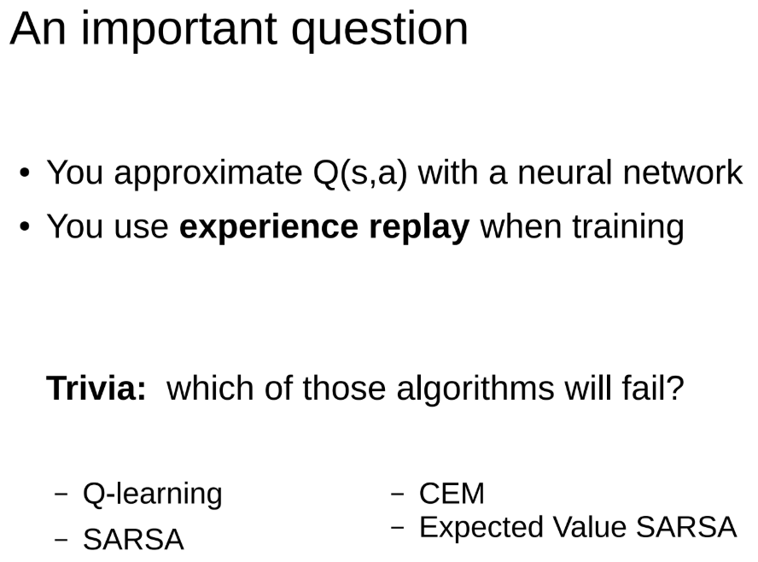
Experience replay
Question:

Slide 21
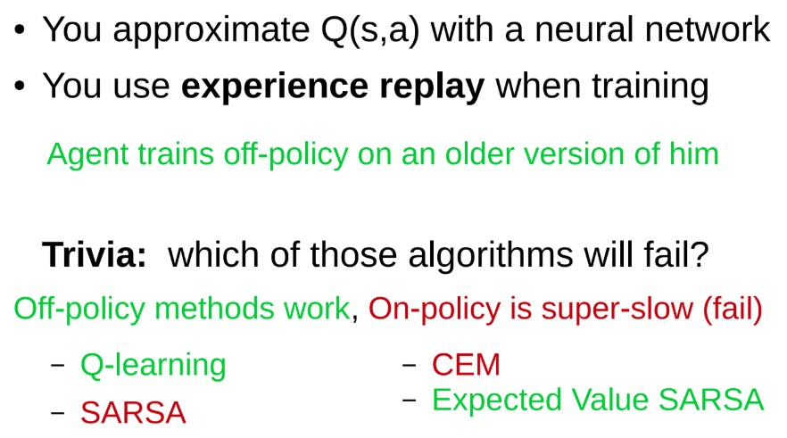
Experience replay
Question:

Slide 22
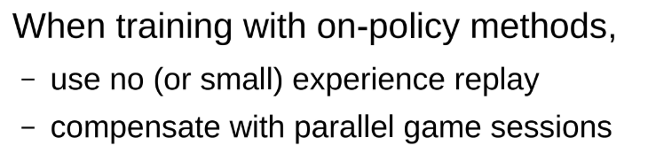

Slide 23
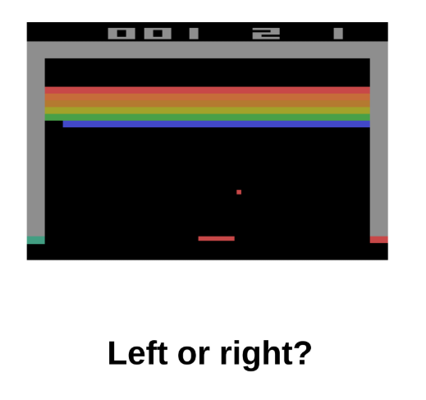

Slide 24
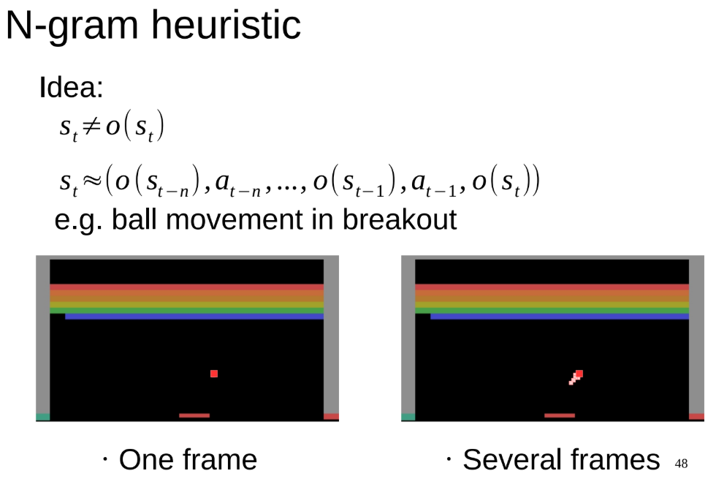
N-gram trick

Slide 25
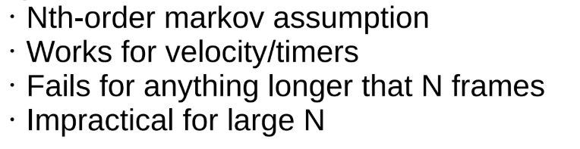
N-gram trick

Slide 26
Autocorrelation
a
...
...
s
s’
x
feed-forward network
Q-values
Target is based on prediction
Q(s, a) correlates with Q(s’, a)

Slide 27
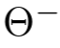
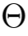
Target network
Idea: use network with frozen weights to compute the target
where is the frozen weights
Hard target network:
Update every n steps and set its weights as
Const

Slide 28
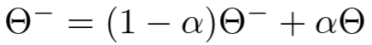
Target network
Idea: use network with frozen weights to compute the target
where is the frozen weights
Hard target network:
Update every n steps and set its weights as
Soft target network:
Update Q_t every step:
Const

Slide 29
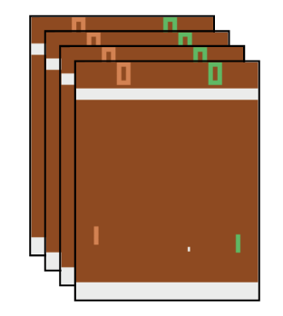
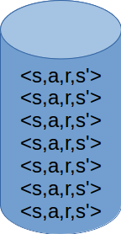
Playing Atari with Deep Reinforcement Learning (2013, Deepmind)
Q-values
Experience replay
CNN
4 last frames as input
Update weights using:
Update every 5000 train steps
10⁶ last transitions

Slide 30
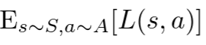
Problem of overestimation
We use “max” operator to compute the target
We have a problem
(although we want to be equal zero)

Slide 31
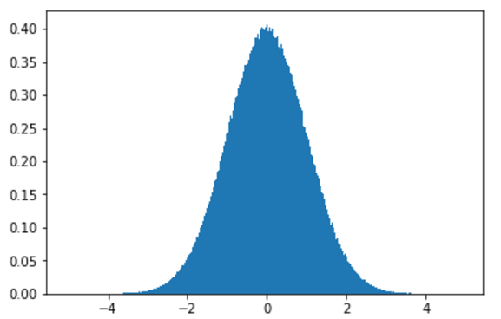
Problem of overestimation
Normal distribution
3*10⁶ samples
mean: ~0.0004

Slide 32
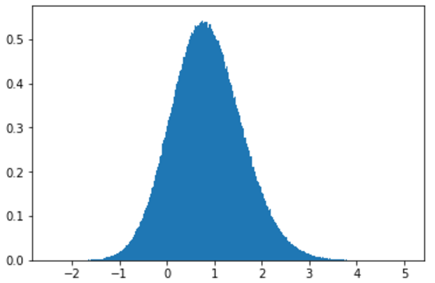
Problem of overestimation
Normal distribution
3*10⁶ x 3 samples
Then take maximum of every tuple
mean: ~0.8467

Slide 33
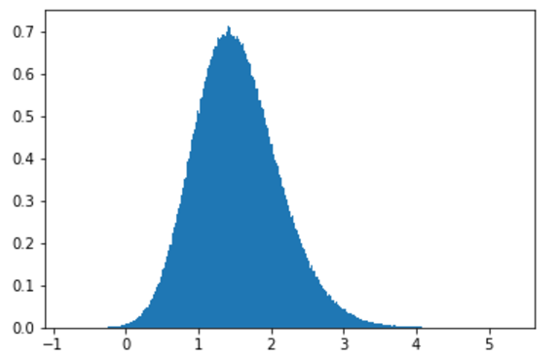
Problem of overestimation
Normal distribution
3*10⁶ x 10 samples
Then take maximum of every tuple
mean: ~1.538

Slide 34
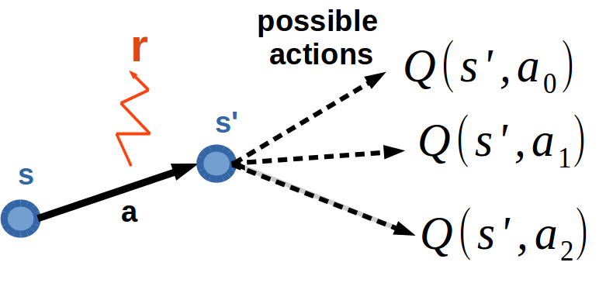
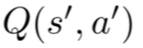
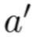
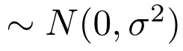
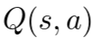
Problem of overestimation
r=0
Suppose true Q(s’,a) are equal to 0 for all a
But we have an approximation (or other) error _ ____
So Q(s,a) should be equal to 0

Slide 35
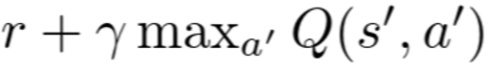
Problem of overestimation
r=0
But if we update Q(s,a) towards _____________________
we will have overestimated Q(s,a) > 0 because

Slide 36
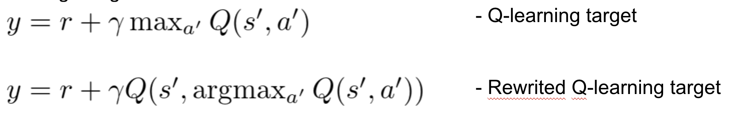
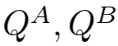
Double Q-learning (NIPS 2010)
Rewritten Q-learning target
Idea: use two estimators of q-values:
They should compensate mistakes of each other because they will be independent
Let’s get argmax from another estimator!

Slide 37
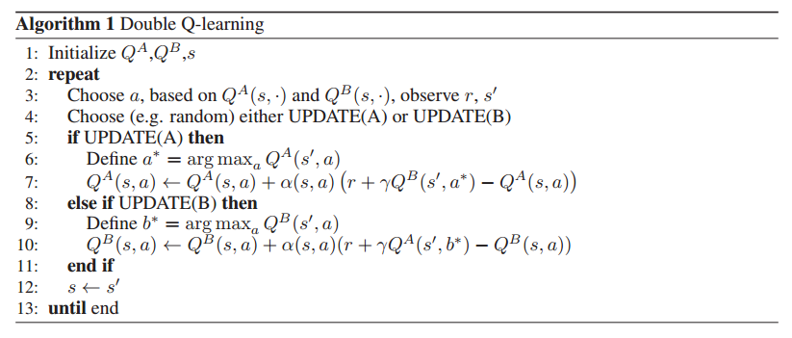
Double Q-learning (NIPS 2010)
Can we combine this algorithm with DQN?

Slide 38



Deep Reinforcement Learning with Double Q-learning (Deepmind, 2015)
Idea: use main network to choose action!

Slide 39
Experience Replay
State | Action | Reward | Next state
s_0 | a_0 | 0 | s_1
s_1 | a_1 | 0 | s_2
... | ... | ... | ...
s_(n-1) | a_(n-1) | 0 | s_n
s_n | a_n | 100 | s_(n+1)
s_(n+1) | a_(n+1) | 0 | s_(n+2)
... | ... | ... | ...

Slide 40


Prioritized Experience Replay (2016, Deepmind)
Idea: sample transitions from xp-replay cleverly
We want to set probability for every transition. Let’s use the absolute value of TD-error of transition as a probability!
Do you see the problem?
where 𝛼 is the priority parameter (when 𝛼 is 0 it’s the uniform case)
Transitions become non i.i.d. and therefore we introduce the bias.

Slide 41


Prioritized Experience Replay (2016, Deepmind)
Solution: we can correct the bias by using importance-sampling weights
where 𝛽 is the parameter
So we sample using and multiply error by

Slide 42


Prioritized Experience Replay (2016, Deepmind)
Additional details
We also normalize weights by (here is no mathematical reason)
When we put transition into experience replay, we set
It is the bonus homework!

Slide 43
Let’s watch a video…
https://www.youtube.com/watch?v=UXurvvDY93o

Slide 44


Dueling Network Architectures for Deep Reinforcement Learning (2016, Deepmind)
Idea: change the network’s architecture.
Recall:
Advantage Function A(s,a) = Q(s,a) - V(s)
So, Q(s,a) = A(s,a) + V(s)
Q(s)
V(s)
Q(s)
A(s)

Slide 45

Dueling Network Architectures for Deep Reinforcement Learning (2016, Deepmind)
Here is one extra freedom degree!
Example:
0
3
2
4
3
2
4
3
2
4
3
-1
1
0
Which one is good?

Slide 46


Dueling Network Architectures for Deep Reinforcement Learning (2016, Deepmind)
Solution: require to be equal to zero!
So the Q-function computes as:

Slide 47

Dueling Network Architectures for Deep Reinforcement Learning (2016, Deepmind)
Solution: require to be equal to zero!
So the Q-function computes as:
Authors of this papers also introduced this way to compute Q-values:
It’s the homework!
They wrote that this variant increases stability of the optimization
(The fact that this loses the original semantics of Q doesn’t matter)

Slide 48

Asynchronous Methods for Deep Reinforcement Learning (2016, Deepmind)
Worker
Worker
Worker
Transitions
Learning

Slide 49

Rainbow (2017, Deepmind)
Double DQN
Prioritized DQN
Dueling DQN
Distributional DQN
Noisy DQN
multi-step DQN
DQN
Algorithm | Median
DQN | 79.5%
Double DQN | 117%
Rainbow | 223%

Slide 50


R2D2 (2018, Deepmind)
LSTM
Reward re-scaling
Distributed Prioritized Experience Replay
Double DQN
n-step DQN
Dueling DQN
Median performance: 1920% of human performance!

Slide 51
Thanks for your attention!

